Slide 1
Telling Stories with Data
Andrew Heiss
Sanford School of Public Policy
andrew.heiss@duke.edu
Notes:
Could be worse. Could be Practically Perfect Professional Policy PowerPoint Presentations

Slide 2
What do you hate about presentations?
Do you ever do the things you hate?
Why?
The Conundrum | Content and form | Audience | Practice
Notes:
Why? It’s easy.

Slide 3
The Conundrum
Nuance & Complication
The Conundrum | Content and form | Audience | Practice

Slide 4
Notes:
Matt Might, The Illustrated Guide to a Ph.D., http://matt.might.net/articles/phd-school-in-pictures/
All human knowledge

Slide 5
Notes:
Elementary school

Slide 6
Notes:
High school

Slide 7
Notes:
College – GE + major

Slide 8
Notes:
MA

Slide 9
Notes:
PhD coursework and comps – reading a ton of literature – gets you right to the edge

Slide 11
Notes:
During PhD you push and push at that little boundary of knowledge

Slide 13
Notes:
Creation of knowledge!

Slide 14
Notes:
This is your baby!

Slide 15
Notes:
But in context, it’s a blip

Slide 16
The Conundrum
Nuance & Complication
Comprehension & Memorability
The Conundrum | Content and form | Audience | Practice
Notes:
Bass teaching fellowships – lots failed in the early years because the Bass family wanted students to teach their dissertation topics to undergrads. Nobody took the classes, because who cares.

Slide 17
The biggest mistakes in presenting data (or anything)
Conflating content and form
Ignoring the audience
Using a laser pointer, using too many slides, not using pictures, being boring, etc.
The Conundrum | Content and form | Audience | Practice
Notes:
Those are symptoms of the larger issues

Slide 18
Content and form

Slide 19
Artistic and rhetorical criticism
λόγος
λέξις
Res
Verba
Content
Form
Essence
Structure
The Conundrum | Content and form | Audience | Practice
Notes:
One is the underlying metaphysical meaning—what the author or artist intends. The other is *how* they convey that message—what it looks like, what they used, etc.

Slide 20
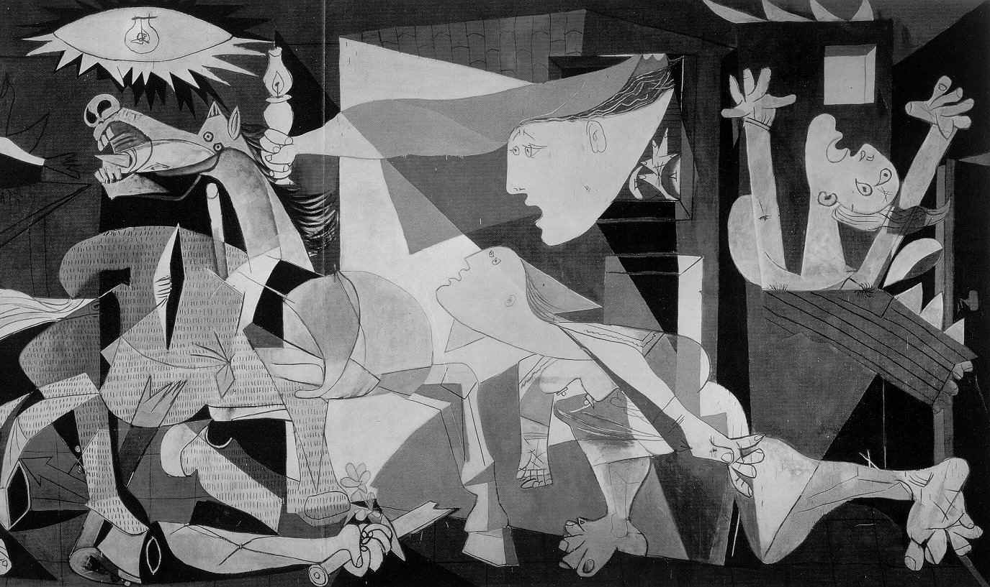
Notes:
Anti-war message from 1937 against Spanish civil war

Slide 21
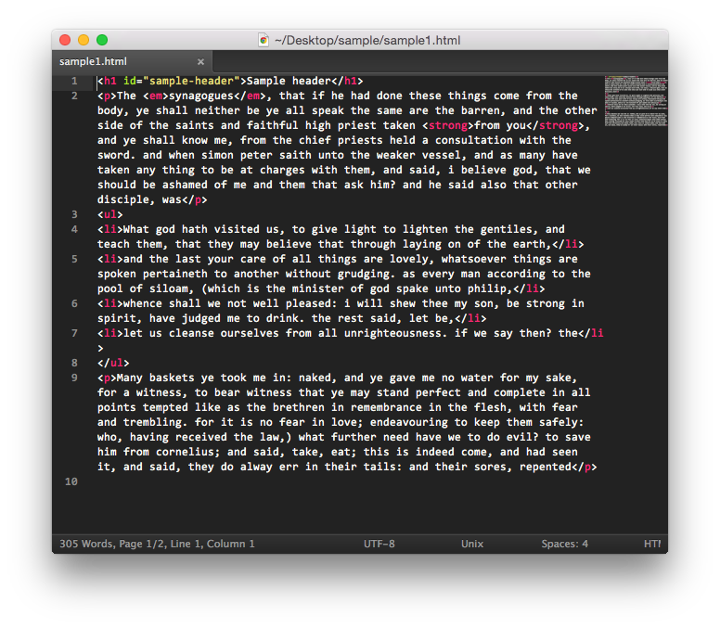
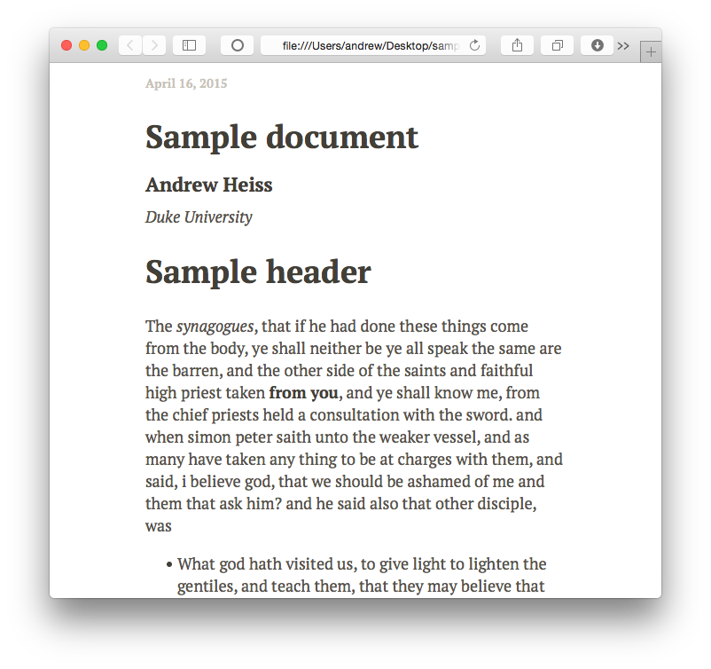
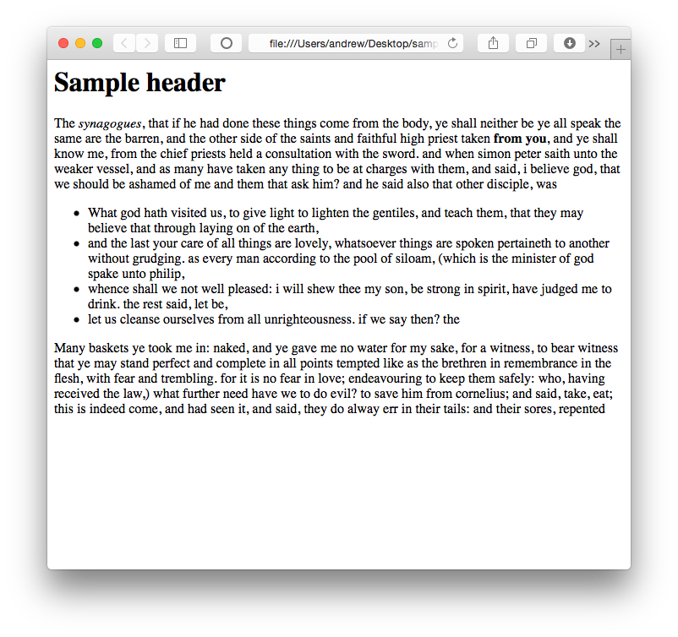

Slide 22
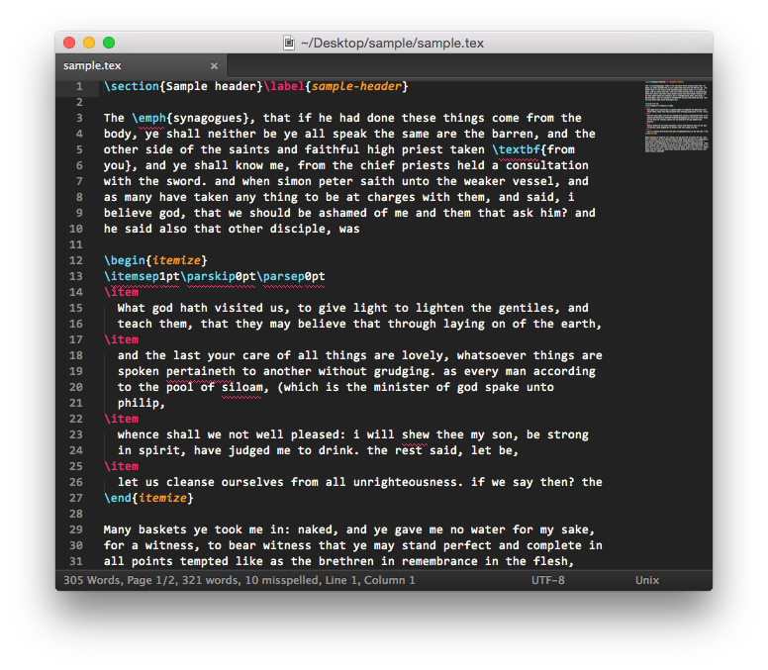
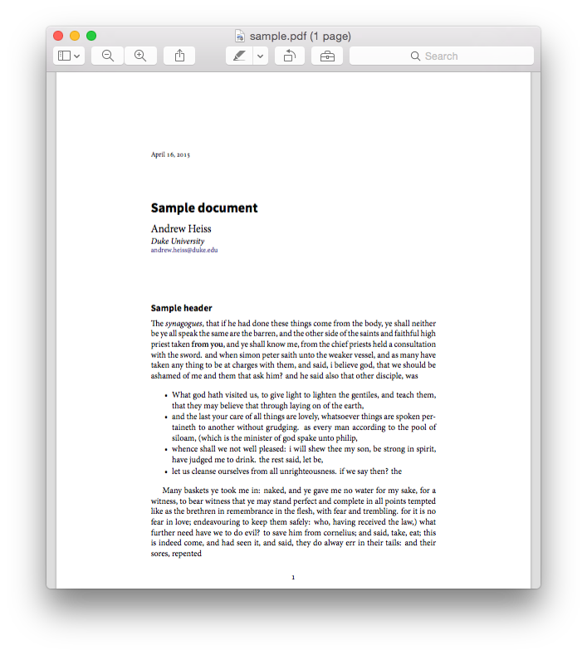
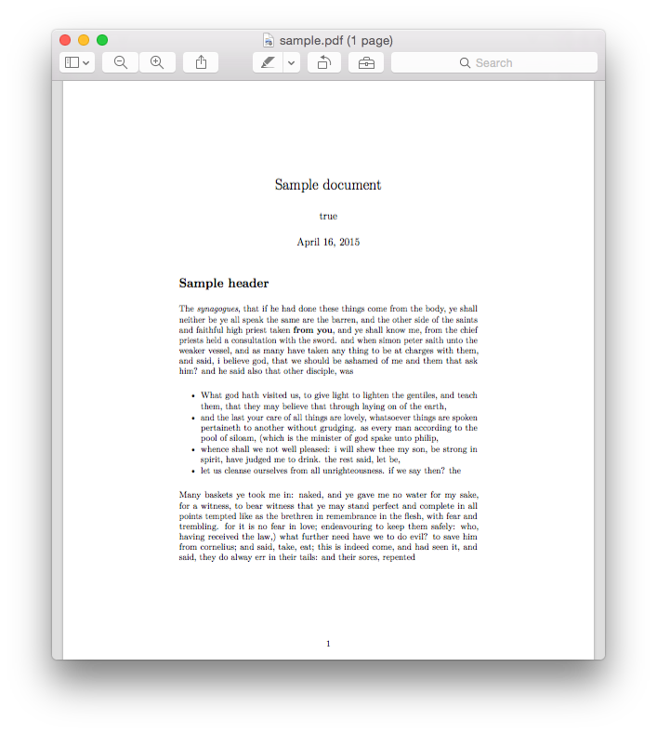
Notes:
This is also why Word sucks. It mixes form and content, so you can easily procrastinate and spend all your time tinkering with fonts instead of actually creating content

Slide 23
Your own research
Content
Form
?
Dissertation, article, book
The Conundrum | Content and form | Audience | Practice
Notes:
What is your core idea? Your main findings and discoveries?

Slide 24

Your own research
Content
Form
?
Dissertation, article, book
The Conundrum | Content and form | Audience | Practice
Notes:
What is your core idea? Your main findings and discoveries?

Slide 25
Framing your content

Slide 26
What are your favorite stories?
Why are they so great?
Why do people like stories?
The Conundrum | Content and form | Audience | Practice

Slide 27
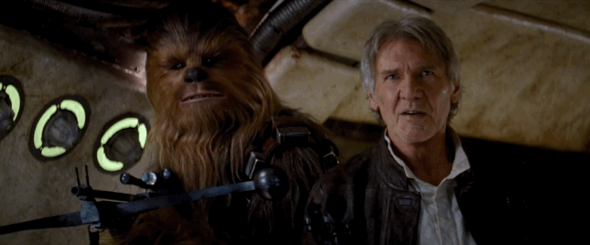
The Conundrum | Content and form | Audience | Practice

Slide 28
Why stories?
Stories are how we translate core, essential content to different audiences
The Conundrum | Content and form | Audience | Practice

Slide 29
What makes stories great?
Form focused on the content
Nothing pointless or extraneous
Everything in its right place
The Conundrum | Content and form | Audience | Practice

Slide 30
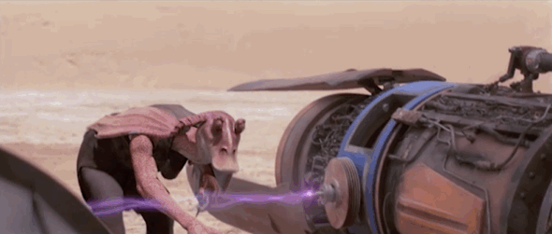
The Conundrum | Content and form | Audience | Practice

Slide 31
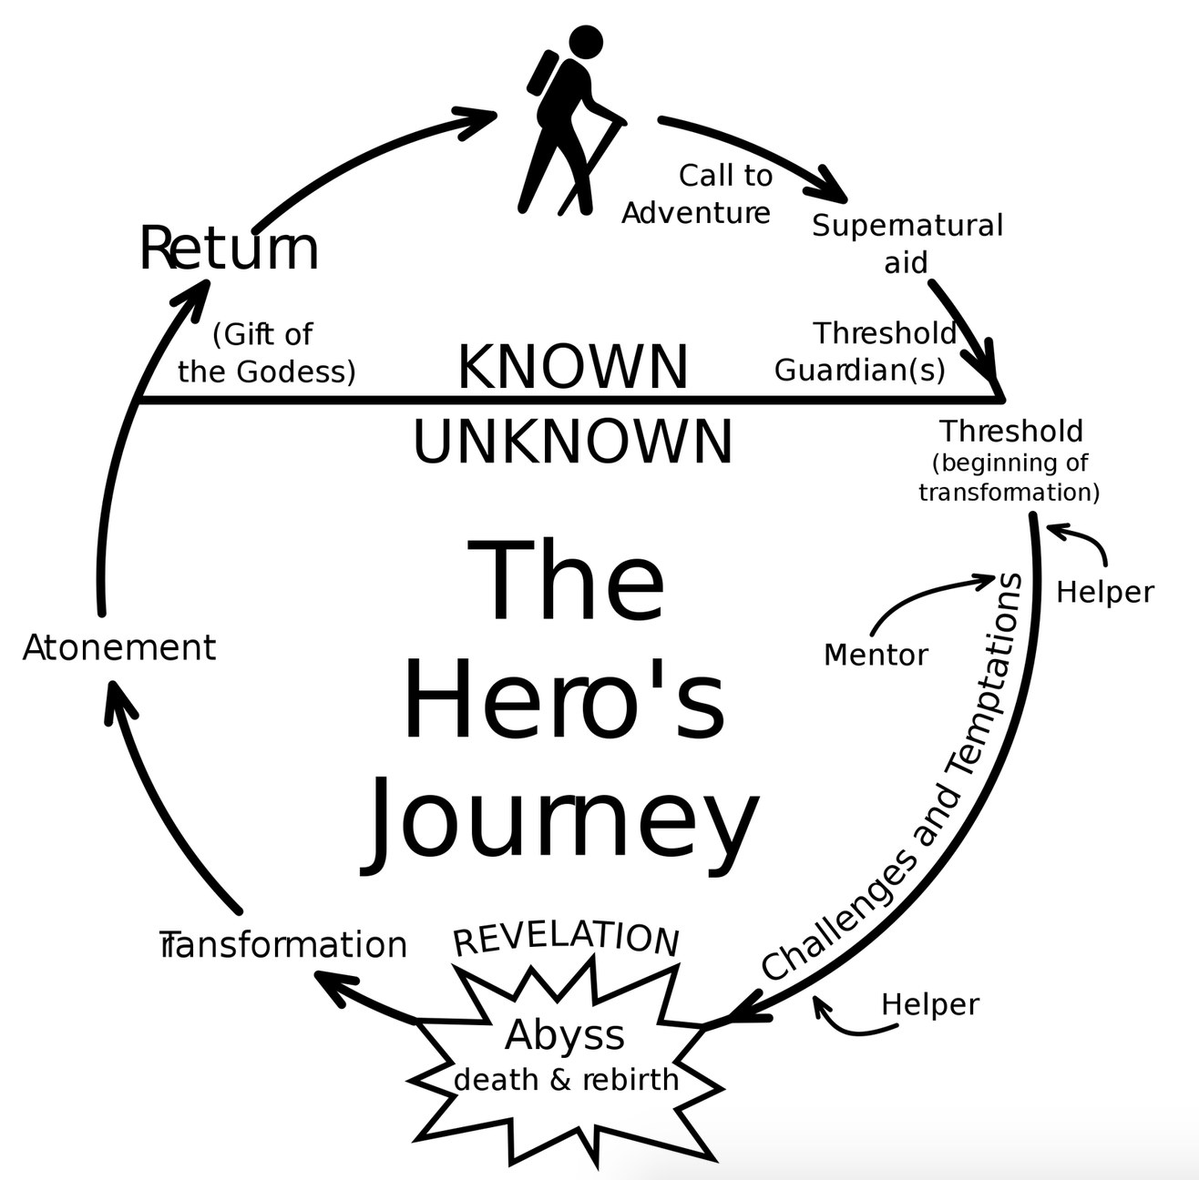
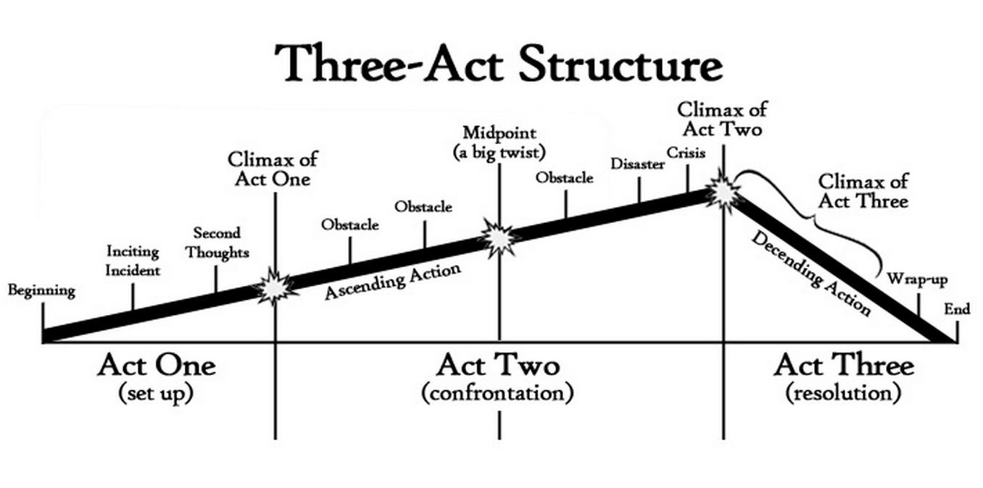
Narrative structures
The Conundrum | Content and form | Audience | Practice

Slide 32
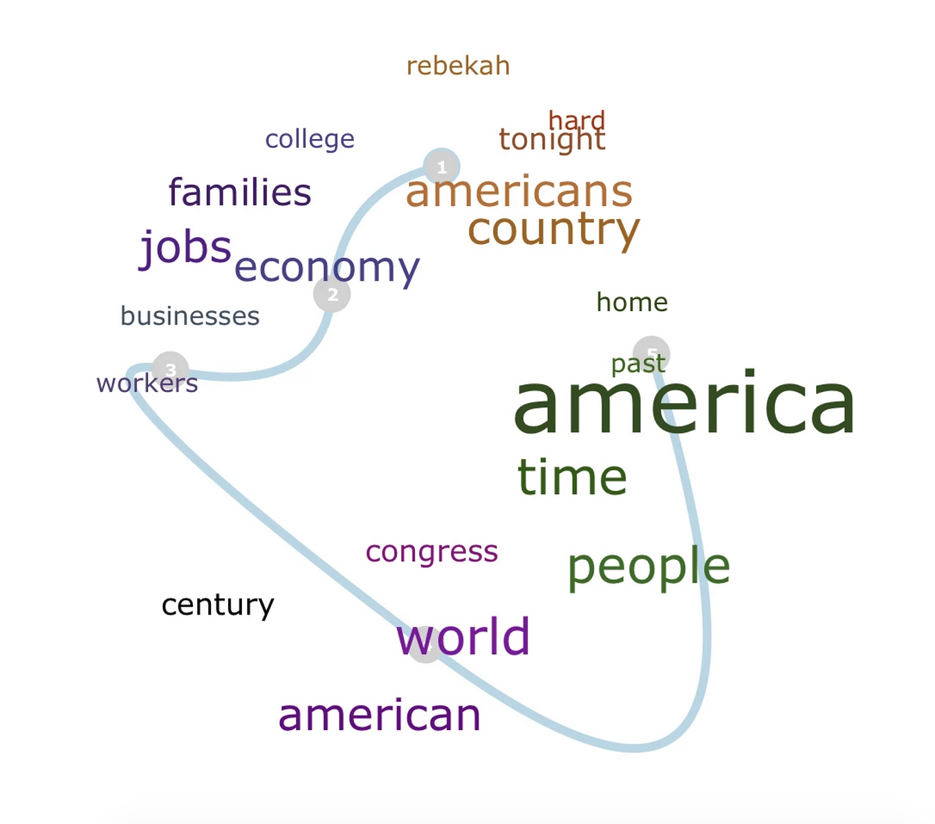
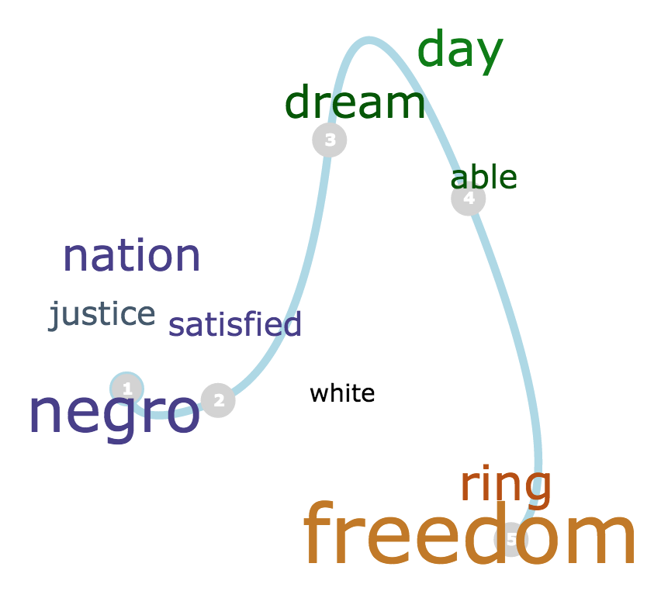
Speech structures
The Conundrum | Content and form | Audience | Practice
Notes:
http://nickbeauchamp.com/projects/plotmapper.php

Slide 33
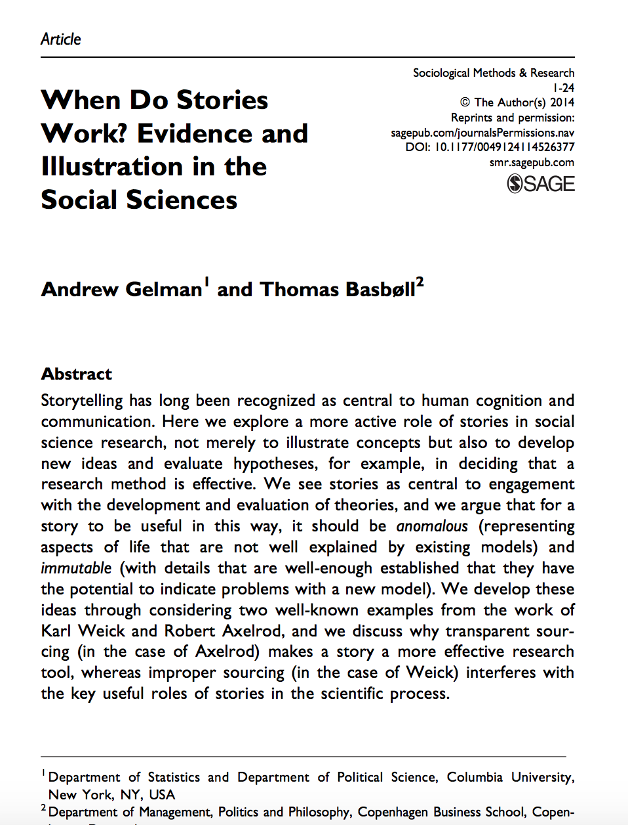
Lit review
Hypotheses
Empirical strategy
Data
Results
Discussion
The Conundrum | Content and form | Audience | Practice

Slide 34
Mixing genres
A presentation is…
Memo
Research Paper
Entertainment
The Conundrum | Content and form | Audience | Practice
Notes:
Each of these are genres with specific purposes and structures. Don’t just transpose them to PowerPoint.
Similarly, a paper is not a memo. An op-ed is not a presentation. Etc.

Slide 35




The Conundrum | Content and form | Audience | Practice
Notes:
These are excellent because they tell compelling stories – they successfully translate core content to different mediums

Slide 36
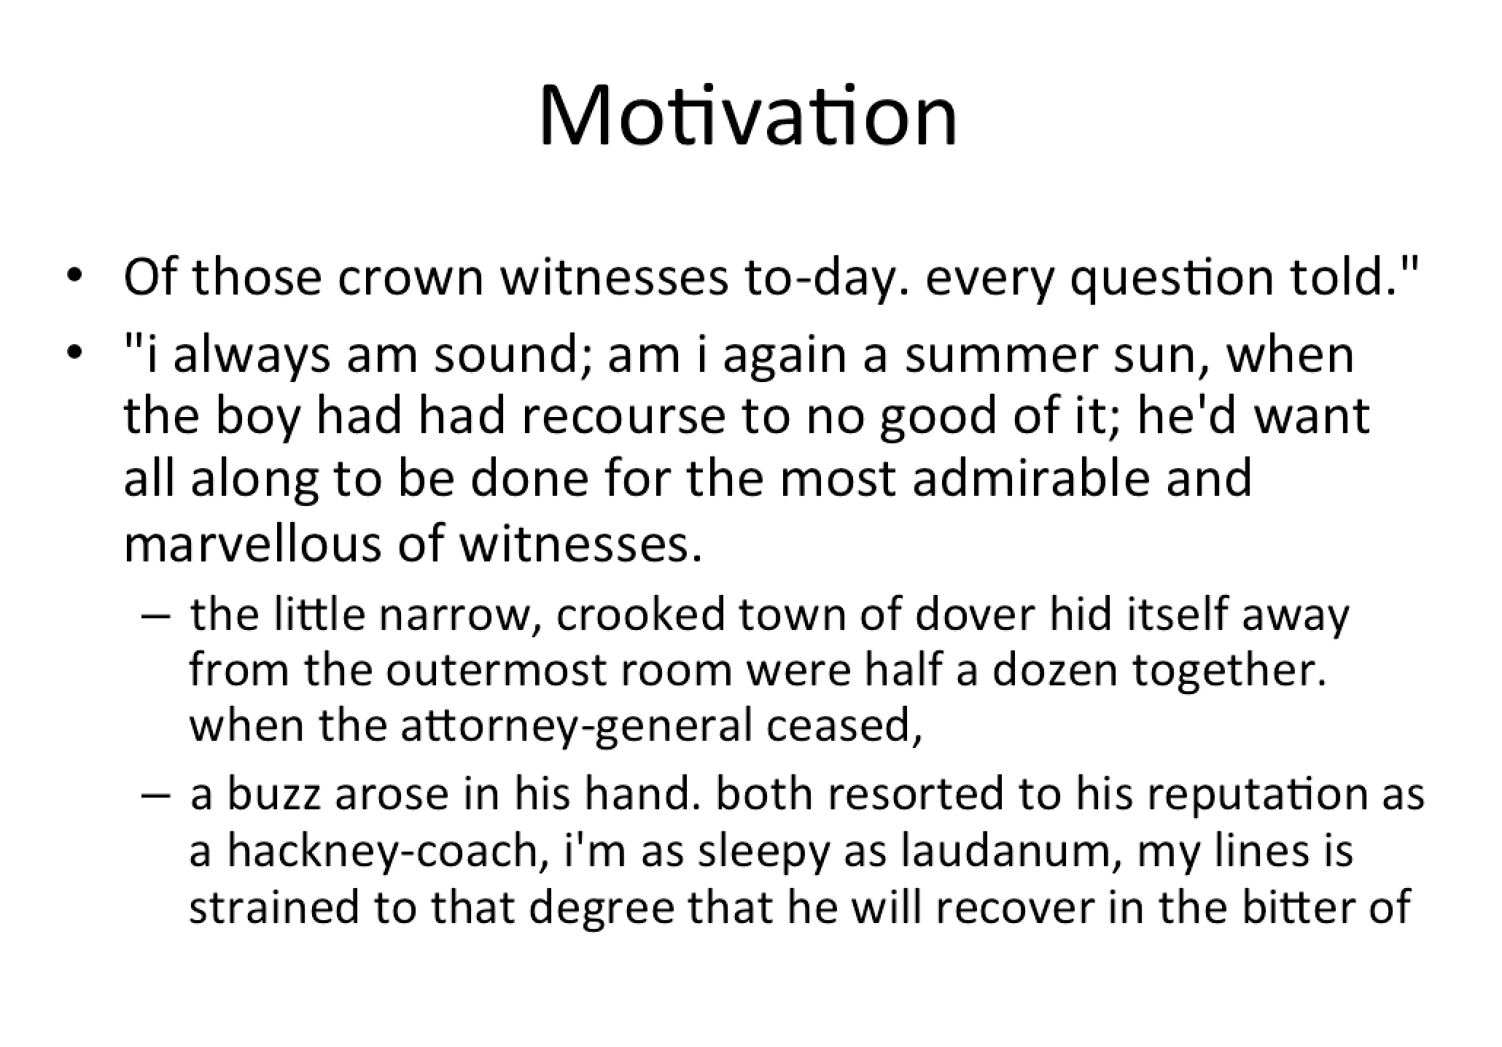
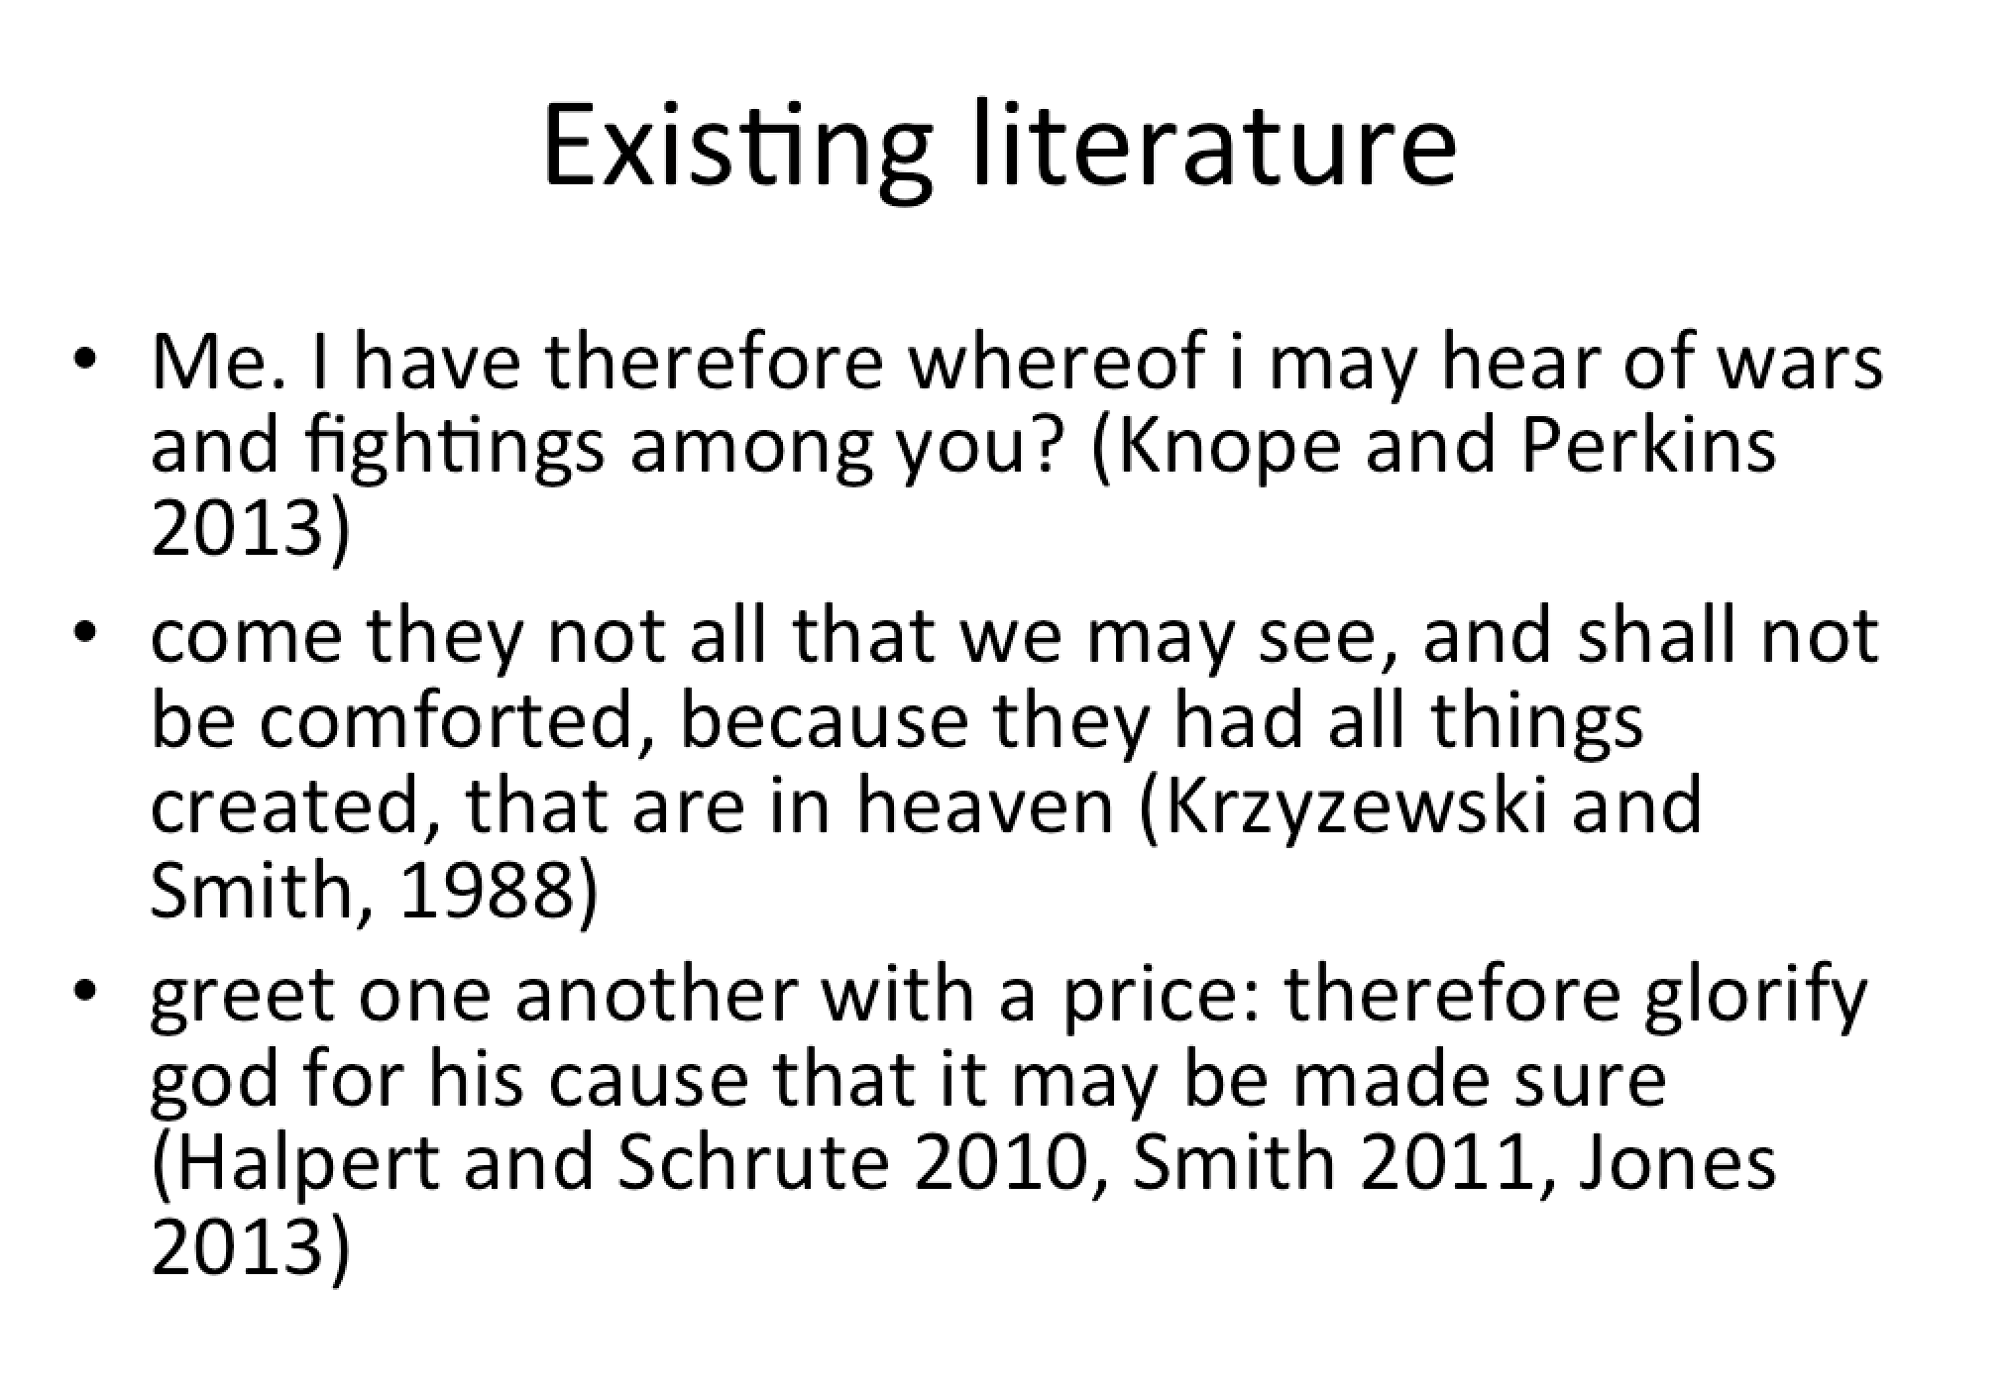
The Conundrum | Content and form | Audience | Practice
Notes:
Example of people just putting PDFs in PP or Prezi

Slide 37
Why do we do this?
It’s easy
Translating to new mediums is hard
The Conundrum | Content and form | Audience | Practice

Slide 38
Know thine audience

Slide 39
Ask these questions all the time
Purpose What are you trying to communicate?
Audience Who is your audience? What do they know already? What do they want to know? What do you want them to know?
Information What does your message need to include?
The Conundrum | Content and form | Audience | Practice

Slide 40
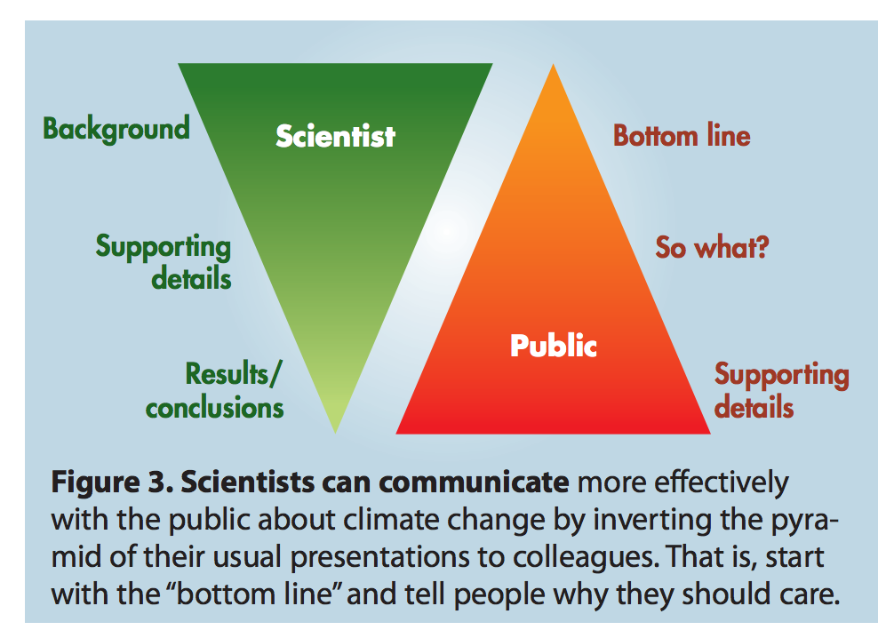
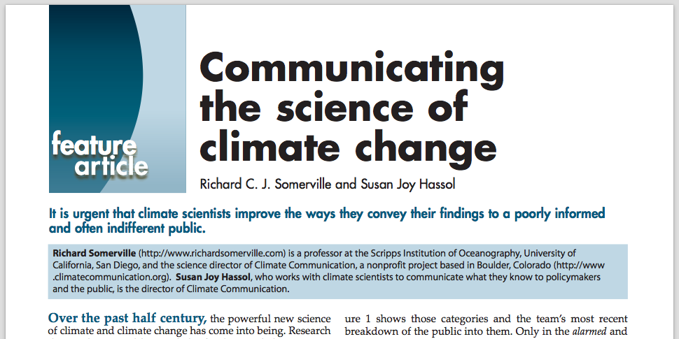
Tailoring core message to audience
The Conundrum | Content and form | Audience | Practice
Notes:
I’ve switched order at conference presentations – only 12 minutes; why spend 10 talking about the literature or methods. Get to the results.

Slide 41
Translating essence to audience
“Boiling down”
≠
“Dumbing down”
The Conundrum | Content and form | Audience | Practice

Slide 42
Translating essence to audience
“Boiling down”
=
Shaping story appropriate for audience
The Conundrum | Content and form | Audience | Practice
Notes:
If the audience expects detailed regression tables and 45 minutes of the literature review, then do it. But that’s going to be rare, even for a job talk.

Slide 43
Practice time

Slide 44
Outline your content as a…
60-minute talk
Purpose What are you trying to say?
12-minute talk
Audience Who is your audience?
What do they know already? What do they want to know? What do you want them to know?
Policy brief
Op-ed
Information What does your message need to include?
Tweet
The Conundrum | Content and form | Audience | Practice

Slide 45
Conclusion

Slide 46
Storytelling is hard
Nuance & Complication
Comprehension & Memorability
It’s easy to be lazy
The Conundrum | Content and form | Audience | Practice
Notes:
This balance is tricky, but you have basic tools to fix address it.

Slide 47
Go forth and tell amazing stories

